Slide 1
GetEasy Redesign Mid-Term Project
CSYE7280 – UX Design
Presented by:
Pranjal gupta - 001094676
Noordeep gill - 002194664
Naman Gupta - 002142933
Alisha Angalan - 002102014

Slide 2

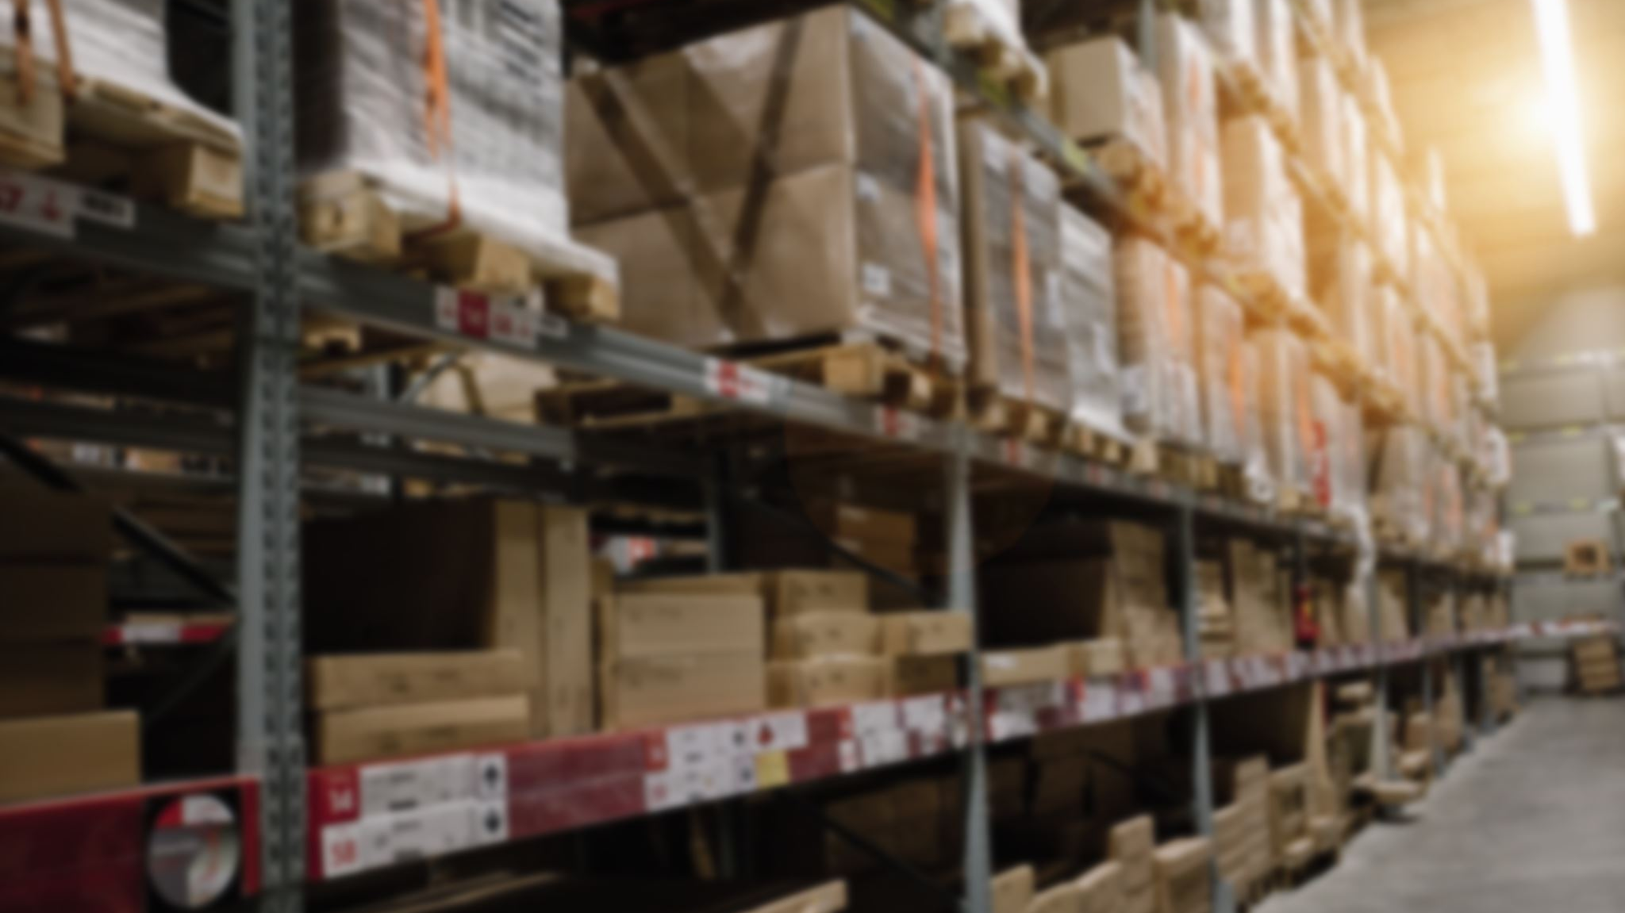
Summary/Overview
GetEasy is an online grocery delivery platform that provides instant delivery where they ship products within 15 minutes, and it also provides the service where they allow customers to select groceries from various retailers and have them delivered by personal shoppers. The platform works together with local warehouse operators as well as popular retailers.

Slide 3
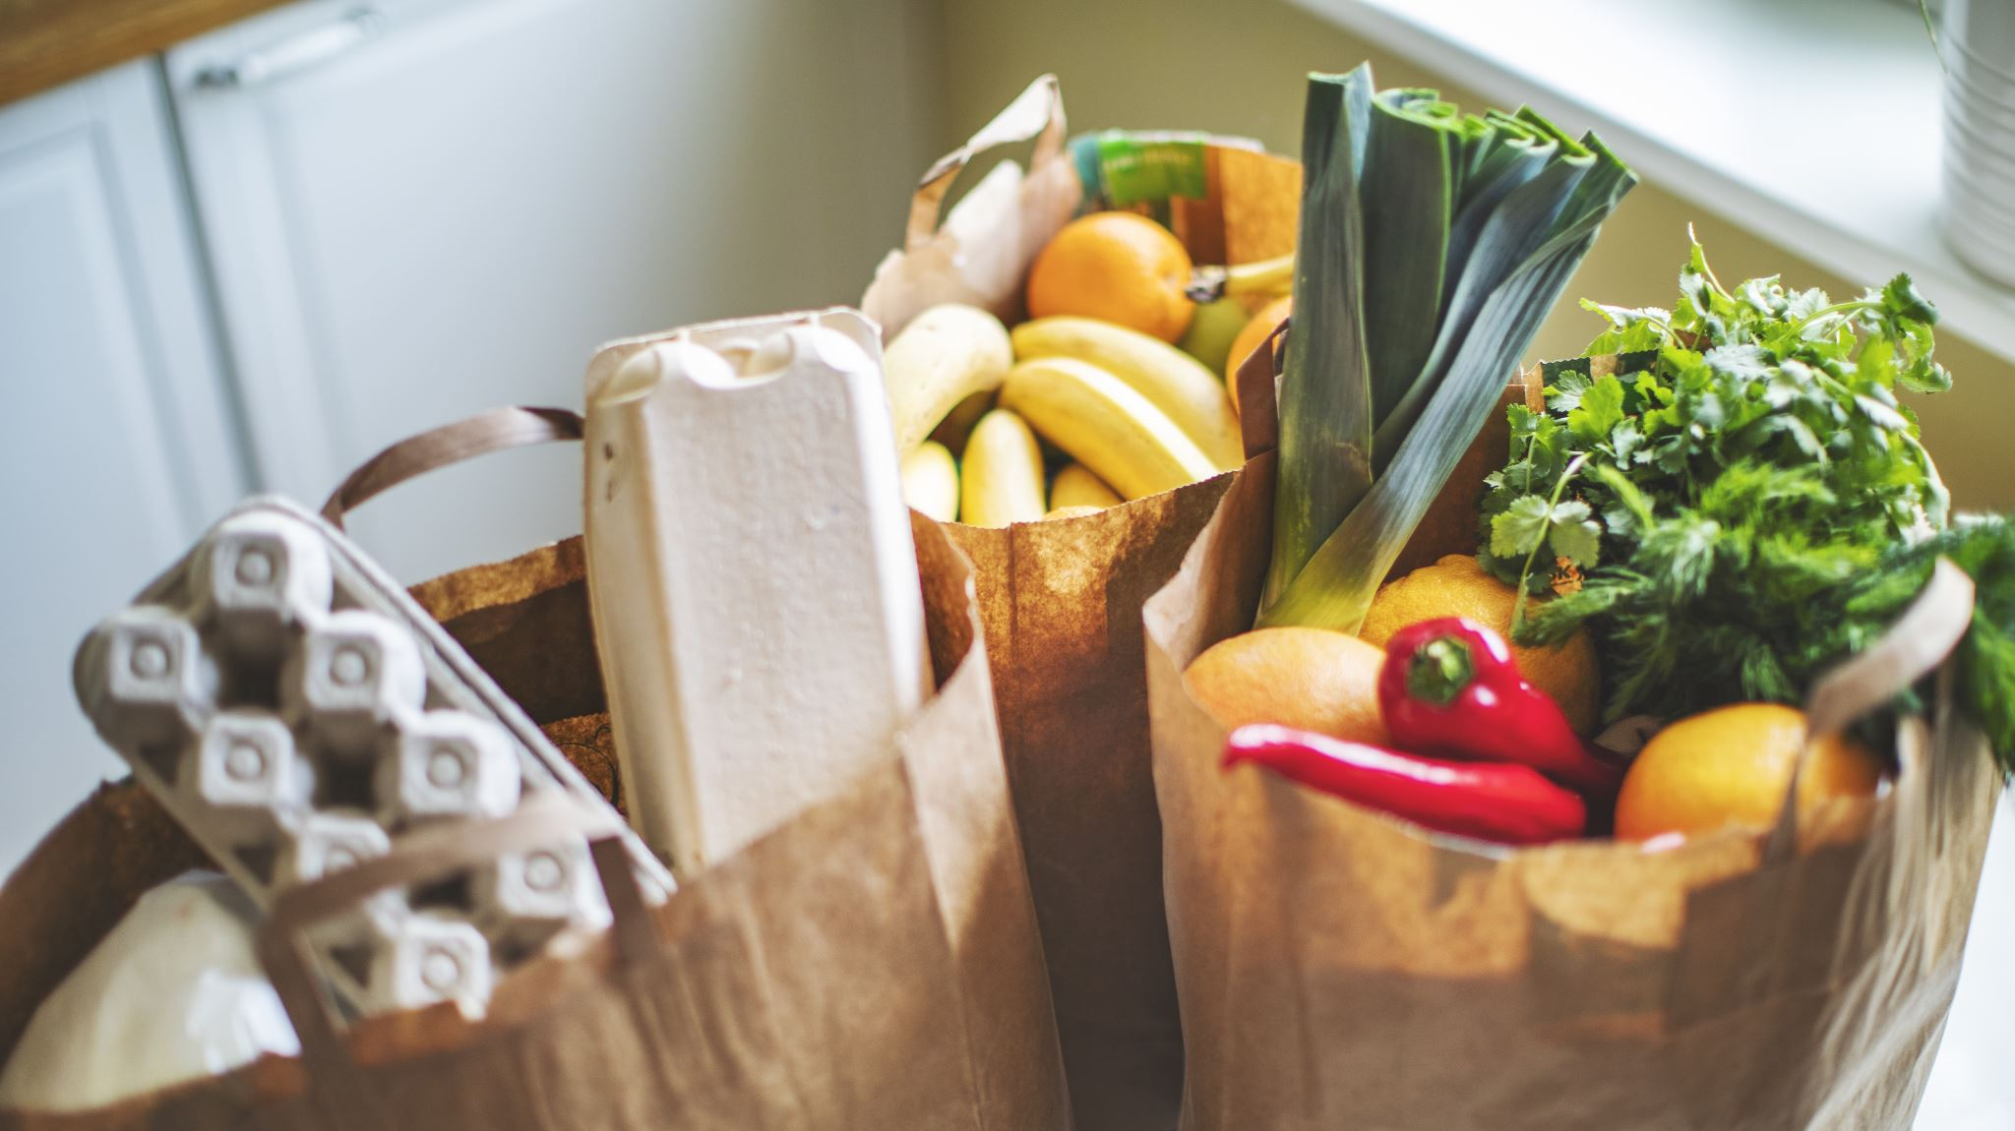
Problem Statement
Online grocery shopping has seen a significant rise in the past few years due to its convenience and availability through multiple applications. It’s getting more difficult for users to spend time in a grocery shop with a well-thought list due to the following issues:
Users with busy schedules may not find the time it takes to shop for items on a regular basis from nearby stores and wait in line for checkout and put the effort to carry them home
Users may prefer to shop from specific stores that may not be easily accessible to them
Users may want an instant delivery of items, say within 20 minutes.
Users may prefer to order fresh groceries daily for cooking purposes.
Users may prefer to have exact quantities of certain items for a meal of exact numbers

Slide 4
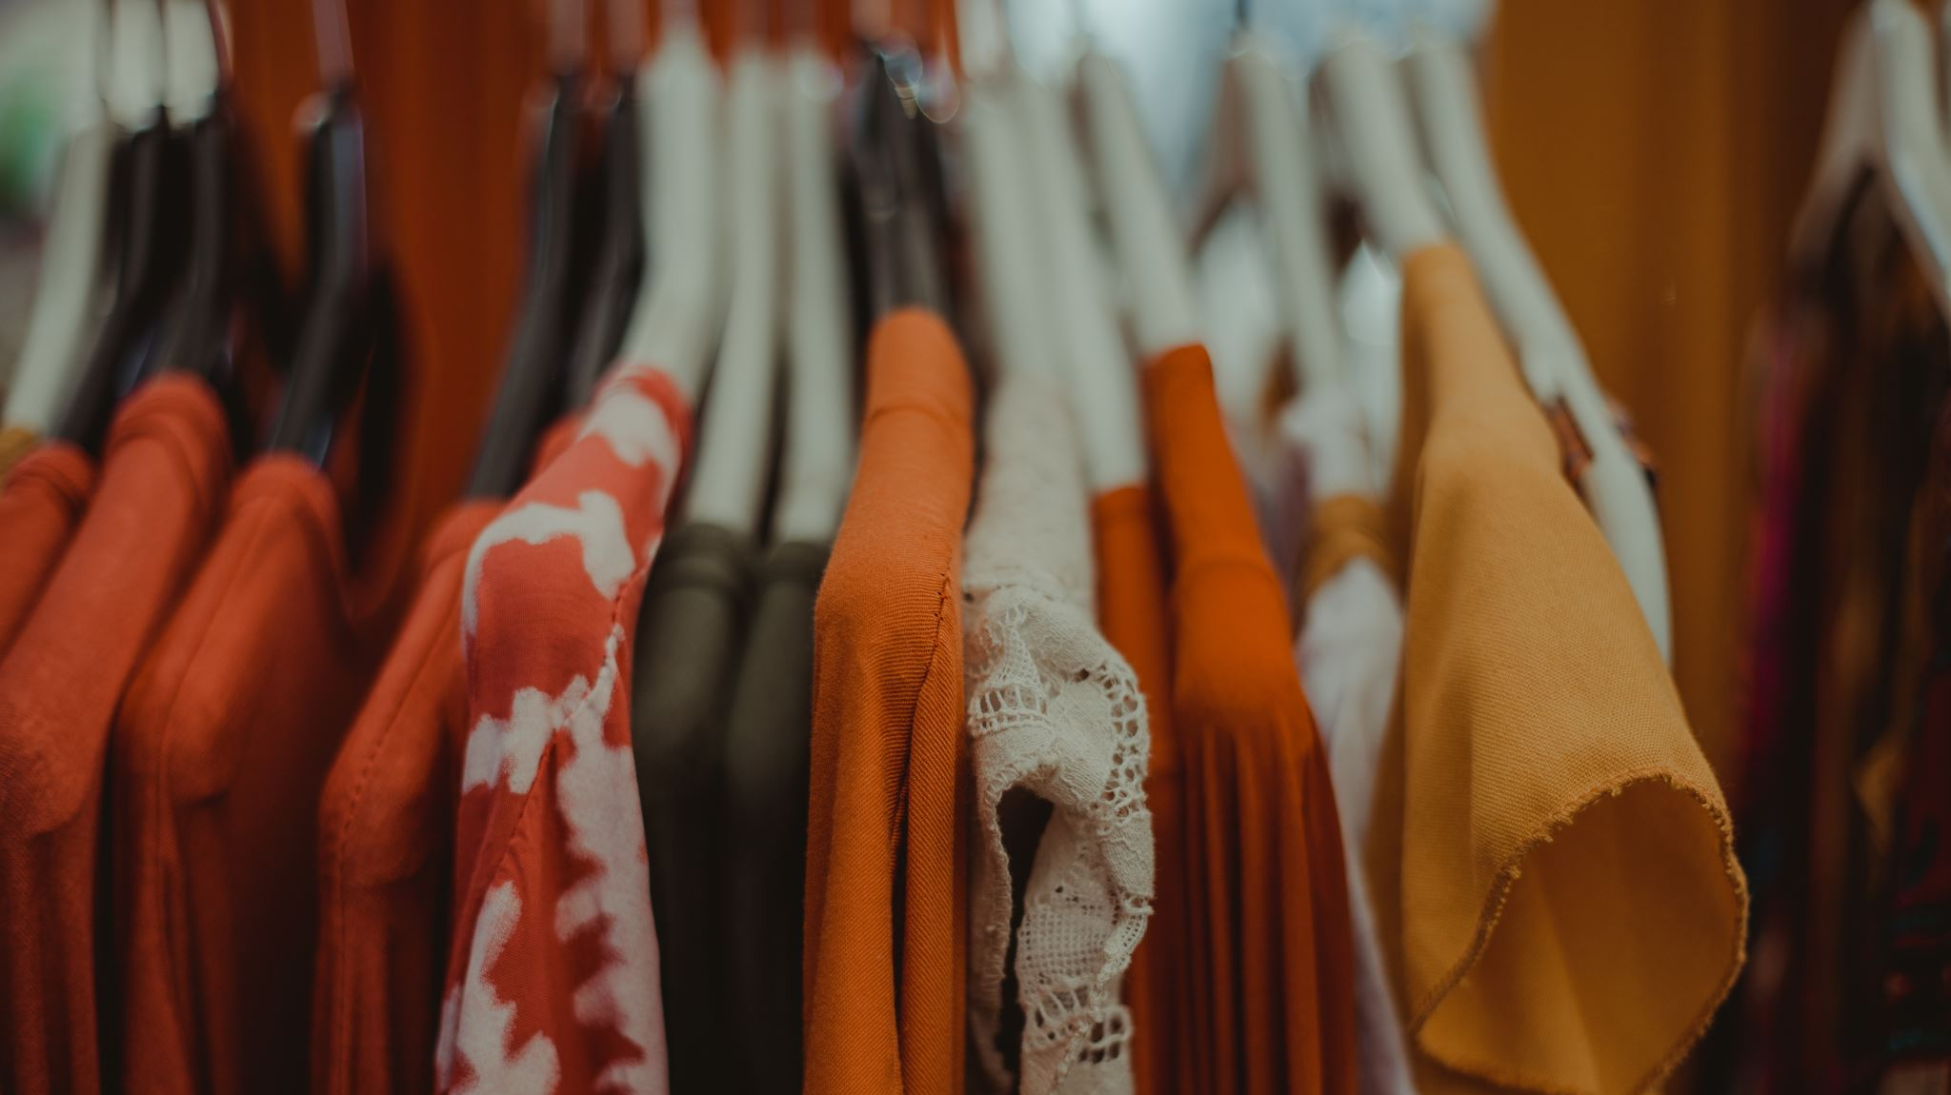
Solution
GetEasy offers solutions to the above issues by:
Enables users to shop from home or on the go and save time.
Providing options for the user to shop from various other retailers.
Helps the users to avoid multiple trips to stores.
Enables the user to get their order instantly (within 15 to 30 mins) or as per select options based on users’ choice.
Enables the users to make an informed decision on the quantity of items required based on certain meals they may intend to make.

Slide 5

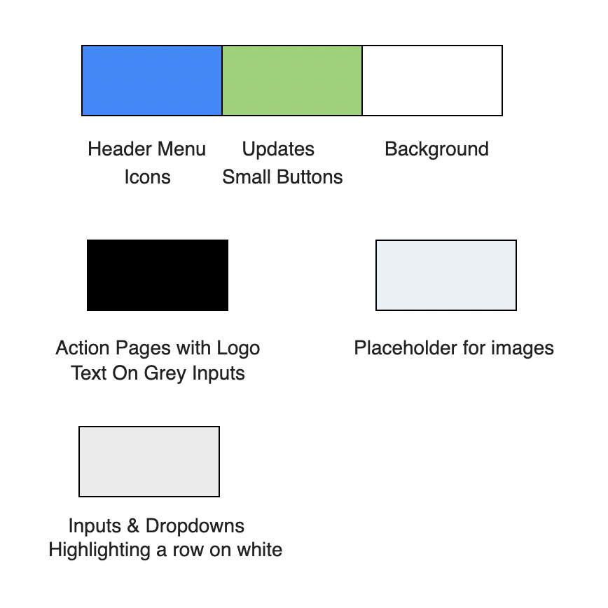



Style Guide

Slide 6
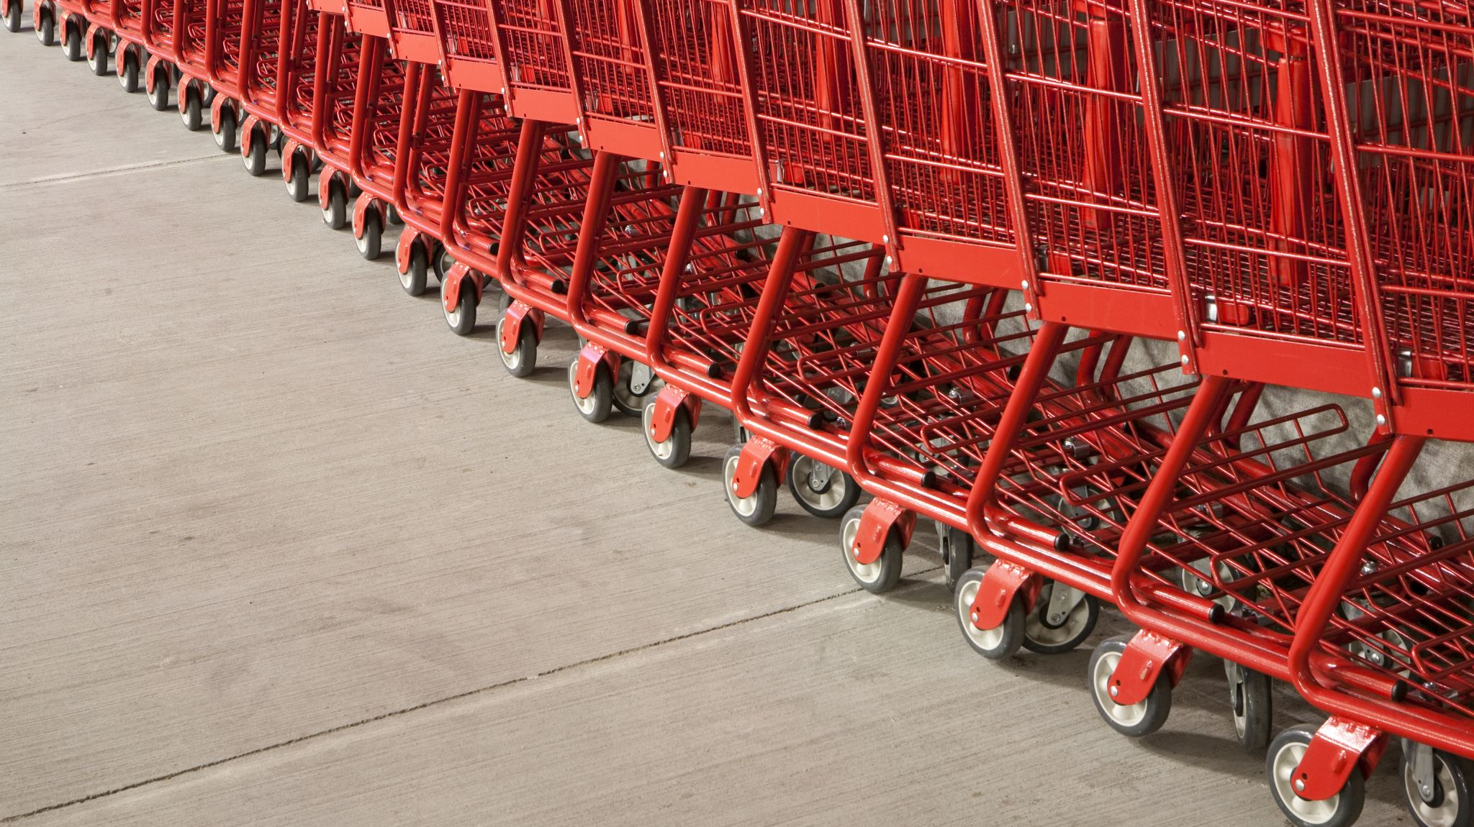
Product Objectives
Allows users to navigate to shop from various stores and from inventory
The delivery promise of goods from our inventory within 30 minutes
Easily visible different options for shopping with one membership for free delivery
Have multiple carts for different stores and inventory orders
Give the user an option to schedule an order for now or later by choosing a time frame
Add/Remove cart items till the shopper has started shopping
Ordering the food items according to a recipe user is searching for
Provide quick checkout
Provide secure payment methods, with an option to scan card to add it
A live chatbot feature which allow users to resolve their doubts through an AI and then rate their experience
Tutorial for first-time users to navigate through the website with an option to skip it
Different authentication methods for user while signing in using credentials.

Slide 7
Audience
Age Group: 15 - 75
Purchasing behavior segmentation: customers who research and read reviews, thrifty shopping, high spenders, cart abandoners, coupon lovers, one-timers, loyal customers
Demographics: All gender, family size from 1 to more, education level from school to above, any occupation, income from $60k and above
Geographic exposure: Within USA and within 50 miles of retailers and inventory stores
Online Shopping Exposure: Low to high exposure to online shopping
Technical Exposure:
Financial Background: Lower and upper middle-class, working, stay at home people

Slide 8
User Segmentation
Age | Gender | Purchase Behavior | Loyalty and Attitude to Product | Online Shopping Exposure | Technical Exposure | Buyer Status | Purchase Frequency | Income
15 - 21 | Any | Special, festive, gift-giving occasion purchase | Enthusiast to product, switches in terms of loyalty, | Mid to High | High | First-time buyer, abandoned cart, | Single purchase, once a month | <$20,000
22 - 45 | Any | Regular purchase | Price and Quality conscious, switcher in terms of loyalty | High | High | Regular buyer, Returned goods | Once a week, once a month | $50,000 to $300,000
46 - 60 | Any | Regular purchase | Loyal, Price and Quality conscious | Mid | Mid | Regular buyer | Once a week | $100,000 to $300,000
61– 70 | Any | Special, festive, gift-giving occasion purchase | Non-loyal, Indifferent, Hostile | None | None | Abandoned cart | Single purchase | <$100,000

Slide 9
User Needs
Clean and consistent UI and design
Instant Delivery for users like working people
Scheduling the orders for future delivery
User Feedback to improve the experience
Editing the placed order cart till the shopping is started for the scheduled order
Live update for store and inventory out-of-stock items
Live chat with the shopper and easy customer support
Easy checkout, secure payments
Relevant product information and reviews
Search and filter options
Product categories to select by user
Live chat and customer support
Enabling guest to place order and checkout
Group checkout of multiple carts

Slide 10
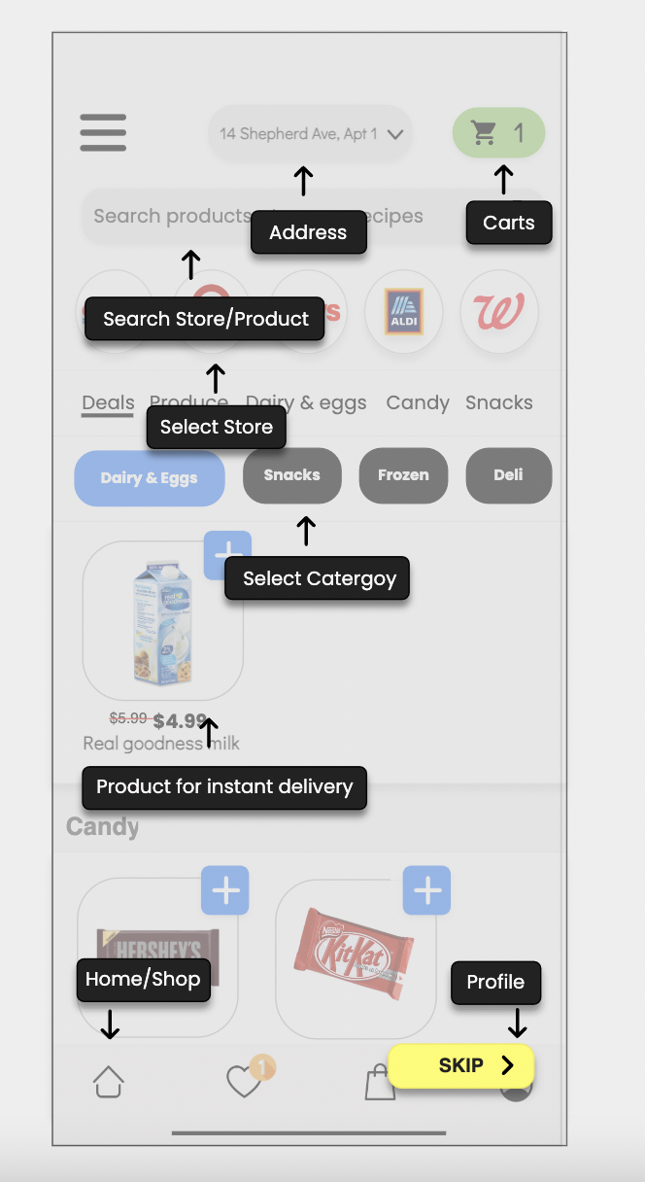
Onboarding
Onboarding is the process of guiding users to navigate through and find value in the product. The different ways to implement user onboarding in our ecommerce website is by:
Tutorials – the user will be given a tutorial on how to navigate through the website using arrow marks, which the user is free to go ahead with or skip if not interested.

Slide 11
Use Cases

Slide 12
Use case 1 | User wants to place an order which they expect to get delivered within 30 mins. They order is dispatched from company warehouse/inventory
Actor | User
Stakeholder | GetEasy
Basic Flow | 1. User logs in with valid username and password. 2. User Searches for the product they need from product catalog. 3. Selects the product from options available and adds them to the cart. 4. Goes to the Cart and selects the Checkout option. 5. For first order they are prompted to add their card/Or existing customer wants to add a new card. 6. He manually adds every card detail to the form page and saves the card details to be used in future. 7. They get the available desired option for delivery 8. Places the order
Termination outcome | User successfully adds a card to the payment details page
Alternative Flow 1 | 1. User logs in with valid username and password. 2. User Searches for the product they need from product catalog. 3. Selects the product from options available and adds them to the cart. 4. Goes to the Cart and selects the Checkout option. 5. For first order they are prompted to add their card/Or existing customer wants to add a new card. 6. He is given an option of uploading the image of his card which enabled automatic filling of card detail to the form page and an option to save the details to be used in future. 7. They get the available desired option for delivery 8. Places the order.
Termination outcome | User successfully adds a card to the payment details page by allowing the app to access photos.
Alternative Flow 2 | 1. User logs in with valid username and password. 2. User Searches for the product they need from product catalog. 3. Selects the product from options available and adds them to the cart. 4. Goes to the Cart and selects the Checkout option. 5. They are given an option to pay via ApplePay 6. They select the option and pay either using their apple id & password or they can use face id for authenticating the payment. 7. They get the available desired option for delivery 8. Places the order.
Termination outcome | User successfully pays at the payment gateway via ApplePay.
Alternative Flow 3 | 1. User logs in with valid username and password. 2. User Searches for the product they need from product catalog. 3. Selects the product from options available and adds them to the cart. 4. Goes to the Cart and selects the Checkout option. 5. They are given an option to pay via PayPal 6. They select the option and insert their PayPal username and password into the PayPal dialog box. 7. Pays using PayPal payment gateway. 8. They get the available desired option for delivery 9. Places the order.
Termination outcome | User successfully pays at the payment gateway via Paypal

Slide 13
Use case 2 | Scheduling a delivery within a time range selected by the user rather than wait for the order based on the time set by the app
Actor | User
Stakeholder | GetEasy
Precondition | 1.The user must be connected to the Internet. 2.The user must have an account in GetEasy
Basic Flow | 1. User logs in with valid username and password. 2. User searches for the product they need from product catalog. 3. User selects the product from options available and adds them to the cart. 4. User goes to the Cart and selects the Checkout option. 5. User selects the payment option and proceeds with the checkout. 6. An estimated date and time of delivery is provided to the user which cannot be changed by the user. 7. User completes checkout.
Termination outcome | User successfully places an order and is given an estimate on when the order will be delivered.
Alternative Flow 1 | 1. User logs in with valid username and password. 2. User searches for the product they need from product catalog from the GetEasy inventory which is available for faster delivery. 3. User selects items within the product and adds them to the cart. 4. User goes to the Cart and selects the Checkout option. 5. User selects the payment option and proceeds with the checkout. 6. User completes checkout successfully and is assigned a rider who delivers the order within the specified estimate. 7. User is able to receive their order within an estimated time of 30 mins due to the items being readily available in the inventory.
Termination outcome | The user navigates to the GetEasy inventory and places an order for the items available in it to get the order delivered within a very short span of time. The user receives the order within an estimate of 30 minutes.
Alternative Flow 2 | 1. User logs in with valid username and password. 2. User searches for a specific retailer from the retailers listed in the app and selects it. 3. User selects items within the inventory of the selected retailer and adds them to cart. 4. User goes to the Cart and selects the Checkout option. 5. User selects the payment option and proceeds with the checkout. 6. User can choose a preferred time window for the order to be delivered. 7. User completes checkout successfully and the order is delivered to them within the requested time window.
Alternative Flow 2 (improvement) | The user can reschedule the time window after checkout and change the time window to a more convenient option for their order to be delivered.
Termination outcome | The user can select a preferred time window before checkout so that their order is delivered within it. The user is also able to change the time window after placing the order and reschedule it to a more convenient option.
Alternative Flow 3 | 1. User logs in with valid username and password. 2. User searches for the product they need from product catalog from the GetEasy inventory which is available for faster delivery. 3. User selects items within the product and adds them to the cart. 4. User goes to the Cart and selects the Checkout option. 5. User selects the payment option and proceeds with the checkout. 6. User completes checkout successfully and is assigned a rider who delivers the order within the specified estimate. 7. User is assigned to a driver and is added to a queue to for order delivery, where the user can see which part of the queue they are, and an estimated time of arrival, say within 30mins to 1hour.
Termination outcome | The user can track the status of the queue and is able to see when their order will be delivered within the provided estimate of fast delivery

Slide 14
Use case 3 | Quick & Easy search for a particular item user wants to buy or have a look at
Actor | User
Stakeholder | GetEasy
Basic Flow | 1. User logs in with valid username and password. 2. User selects the brand-specific store (like Costco / 7-eleven) from where they want their order. 3. User is redirected to the store-specific page showing the items and categories in that store. 4. User Searches for the product they need from the search bar. 5. All the items matching the search will load on the page.
Termination outcome | User searches for the item without going through the hassle of trying to find a particular category
Alternative Flow 1 | 1. User logs in with valid username and password. 2. From the Category bar, the user clicks on a category. 3. Clicking on the category will redirect the user to a separate page where multiple subcategories are displayed. 4. User clicks the subcategory from the redirected page which would refresh to display the items matching the selected subcategories. 5. For first order they are prompted to add their card/Or existing customer wants to add a new card. 6. He is given an option of uploading the image of his card which enabled automatic filling of card detail to the form page and an option to save the details to be used in future. 7. Places the order.
Termination outcome | User searches for the items by drilling down through multiple levels of categories
Alternative Flow 2 | 1. User logs in with valid username and password. 2. User selects the brand-specific store (like Costco / 7-eleven) from where they want their order. 3. User is redirected to the store-specific page showing the items and categories in that store. 4. From the Category bar in the store-specific page, the user clicks on a category. 5. Clicking on the category will redirect the user to a separate page where multiple subcategories are displayed. 6. User clicks the subcategory from the redirected page which would refresh to display the items matching the selected subcategories.
Termination outcome | User searches for the items from a specific store by drilling down through multiple levels of categories

Slide 15
Use case 4 | User adds credit/debit card details in the payment method
Actor | User
Stakeholder | GetEasy
Basic Flow | 1.User logs in with valid username and password. 2.User selects a retailer from where they want their order or selects an item from the inventory. 3.User adds the products to cart. 4.User goes to the cart and selects the checkout option. 5.User is prompted to add card details at payment if there’s no default payment method already added. 6.User is also able to add a new card other than the default method. 7.User manually enters the card details and saves it. 8.User places the order.
Termination outcome | User adds the new credit/debit card manually as a payment method.
Alternative Flow 1 | 1.User logs in with valid username and password. 2.User selects a retailer from where they want their order or selects an item from the inventory. 3.User adds the products to cart. 4.User goes to the cart and selects the checkout option. 5.User is prompted to add card details at payment if there’s no default payment method already added. 6.User is able to scan their card by clicking on the scan icon and the details are filled automatically in the fields. 7.User saves the card details. 8.User places the order.
Termination outcome | User adds the new credit/debit card as a payment method by scanning the card.
Alternative Flow 2 | 1.User logs in with valid username and password. 2.User selects a retailer from where they want their order or selects an item from the inventory. 3.User adds the products to cart. 4.User goes to the cart and selects the checkout option. 5.User is prompted to add card details at payment if there’s no default payment method already added. 6.User is able to upload an image of the card and the details get auto filled into the fields. 7.User saves the card details. 8.User places the order.
Termination outcome | User adds the new credit/debit card as a payment method by uploading an image of the card.

Slide 16
Use case 5 | User is able to place an order as a guest without login/sign up.
Actor | User
Stakeholder | GetEasy
Basic Flow | 1.New user accesses the GetEasy application 2.User selects a retailer from where they want their order and add items to cart or selects an item from the inventory. 3.User adds the products to cart 4.User goes to the cart and selects the checkout option. 5.User is prompted to either login or register without which they cannot complete checkout 6.User creates an account with GetEasy and logs in and completes checkout
Termination outcome | New user can access the application as a guest but must either register or log in to complete their checkout.
Alternative Flow 1 | 1.New user accesses the GetEasy application 2.User selects a retailer from where they want their order and add items to cart or selects an item from the inventory. 3.User adds the products to cart 4.User goes to the cart and selects the checkout option. 5.User is asked whether they want to continue as Guest. 6.User continues as Guest and add address, payment and contact details, and completes checkout.
Termination outcome | New user can access the application as a guest and is able to add just the required details to complete checkout without logging in or registering in the application.

Slide 17
Use case 6 | User is able to combine checkout and place a single order of multiple carts or place a separate order w.r.t retailer cart
Actor | User
Stakeholder | GetEasy
Basic Flow | 1.User logs in with valid username and password. 2.User selects multiple retailers from where they want their order and adds items to their respective carts. 3.User is able to see the combined number of items they have added on the corner of the screen 4.User clicks on the cart and is able to see the cart of every retailer separately listed. 5.User is given options to “Continue Shopping” across each retailer cart. 6.User places an order with each retailer separately.
Termination outcome | User is able to shop from multiple retailers by completely checkout separately from each retailer cart.
Alternative Flow 1 | 1.User logs in with valid username and password. 2.User selects multiple retailers from where they want their order and adds items to their respective carts. 3.User is able to see the combined number of items they have added on the corner of the screen 4.User clicks on the cart and is able to view all the separate retailer carts listed. 5.User is able to select the required carts and complete checkout.
Alternative Flow 1 (with improvements) | User is able to view their cart of added items from each retailer by going to the respective retailer cart. User can also view the added items as a dropdown from each cart at checkout.
Termination outcome | User is able to do a combined checkout of multiple carts from different retailers.

Slide 18
Use case 7 | User is able to securely sign in from a new device through SSO or OTP approval
Actor | User
Stakeholder | GetEasy
Basic Flow | 1.User opens the application from a new device 2.User navigates to the Login page and enters the username and password 3.User logs into the application and is able to view their homepage and respective information
Termination outcome | User is able to login to their application from a new device without having to do any SSO or OTP verification.
Alternative Flow 1 | 1.User opens the application from a new device 2.User navigates to the Login page and enters the username and password 3.User chooses an option to approve an SSO or receive an OTP 4.User chooses the SSO option and approves the request 5.User logs in to their account in the application
Termination outcome | User is able to login to their application successfully after verifying through SSO or OTP

Slide 19
Use case 8 | User is able to add the required items for a particular recipe based as per the given quantities and number of portions
Actor | User
Stakeholder | GetEasy
Basic Flow | 1.User logs into the application with valid username and password. 2.User goes to the “Recipes” category and searches for a dish 3.User views the video and notes the list of ingredients required for the meal 4.User goes to a retailer or inventory and adds each item to cart and estimates the requirement 5.User completes checkout and order is placed
Termination outcome | User adds items based on the list available from the dish shown in the app and places an order.
Alternative Flow 1 | 1.User logs into the application with valid username and password. 2.User goes to the “Recipes” category and searches for a dish 3.User views the video and enters the number of portions for the meal. User then selects an option to add the items required for the meal in the right quantity. 4.User can modify the cart if needed and is able to place an order
Termination outcome | User is able to select number of portions and add items from the recipe section itself. The application adds items from their inventory into the users’ cart. User is able to modify the cart and place an order.

Slide 20
Personas

Slide 21
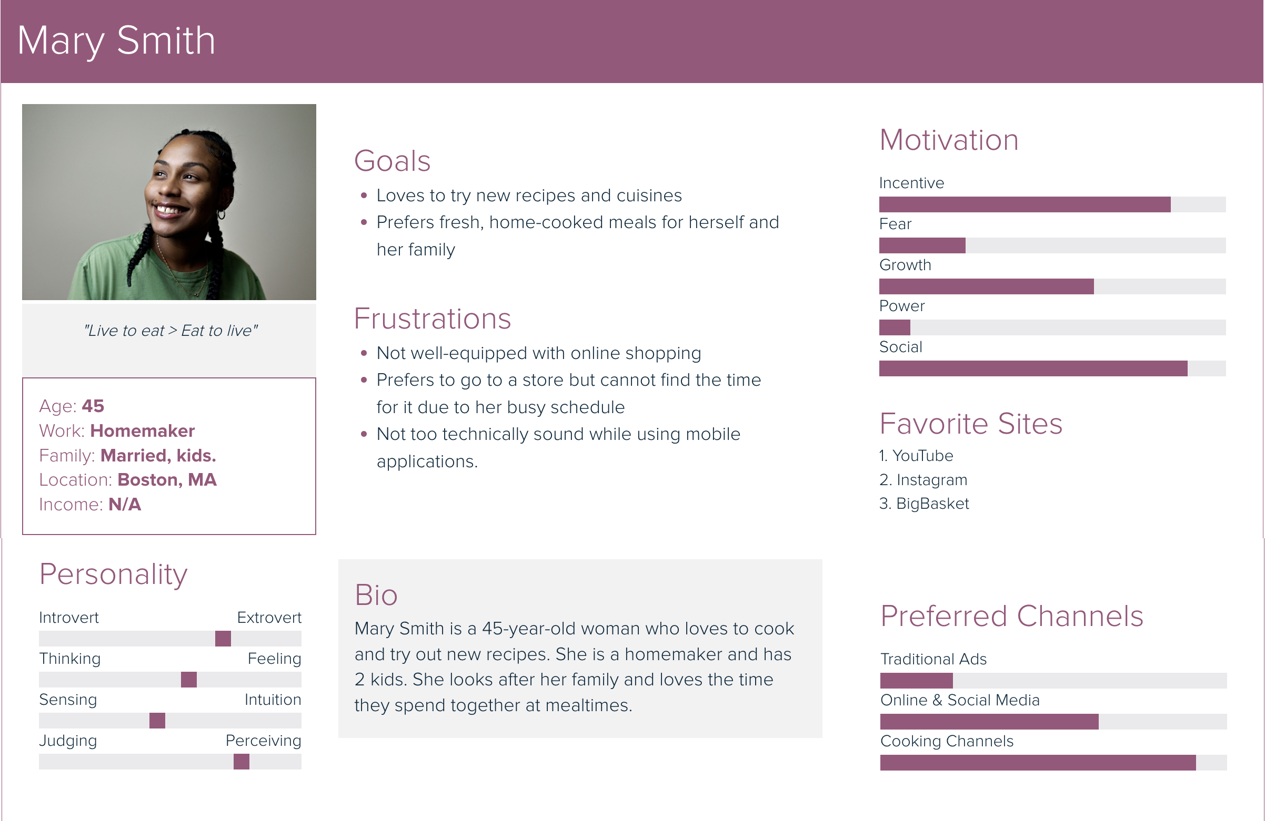

Slide 22
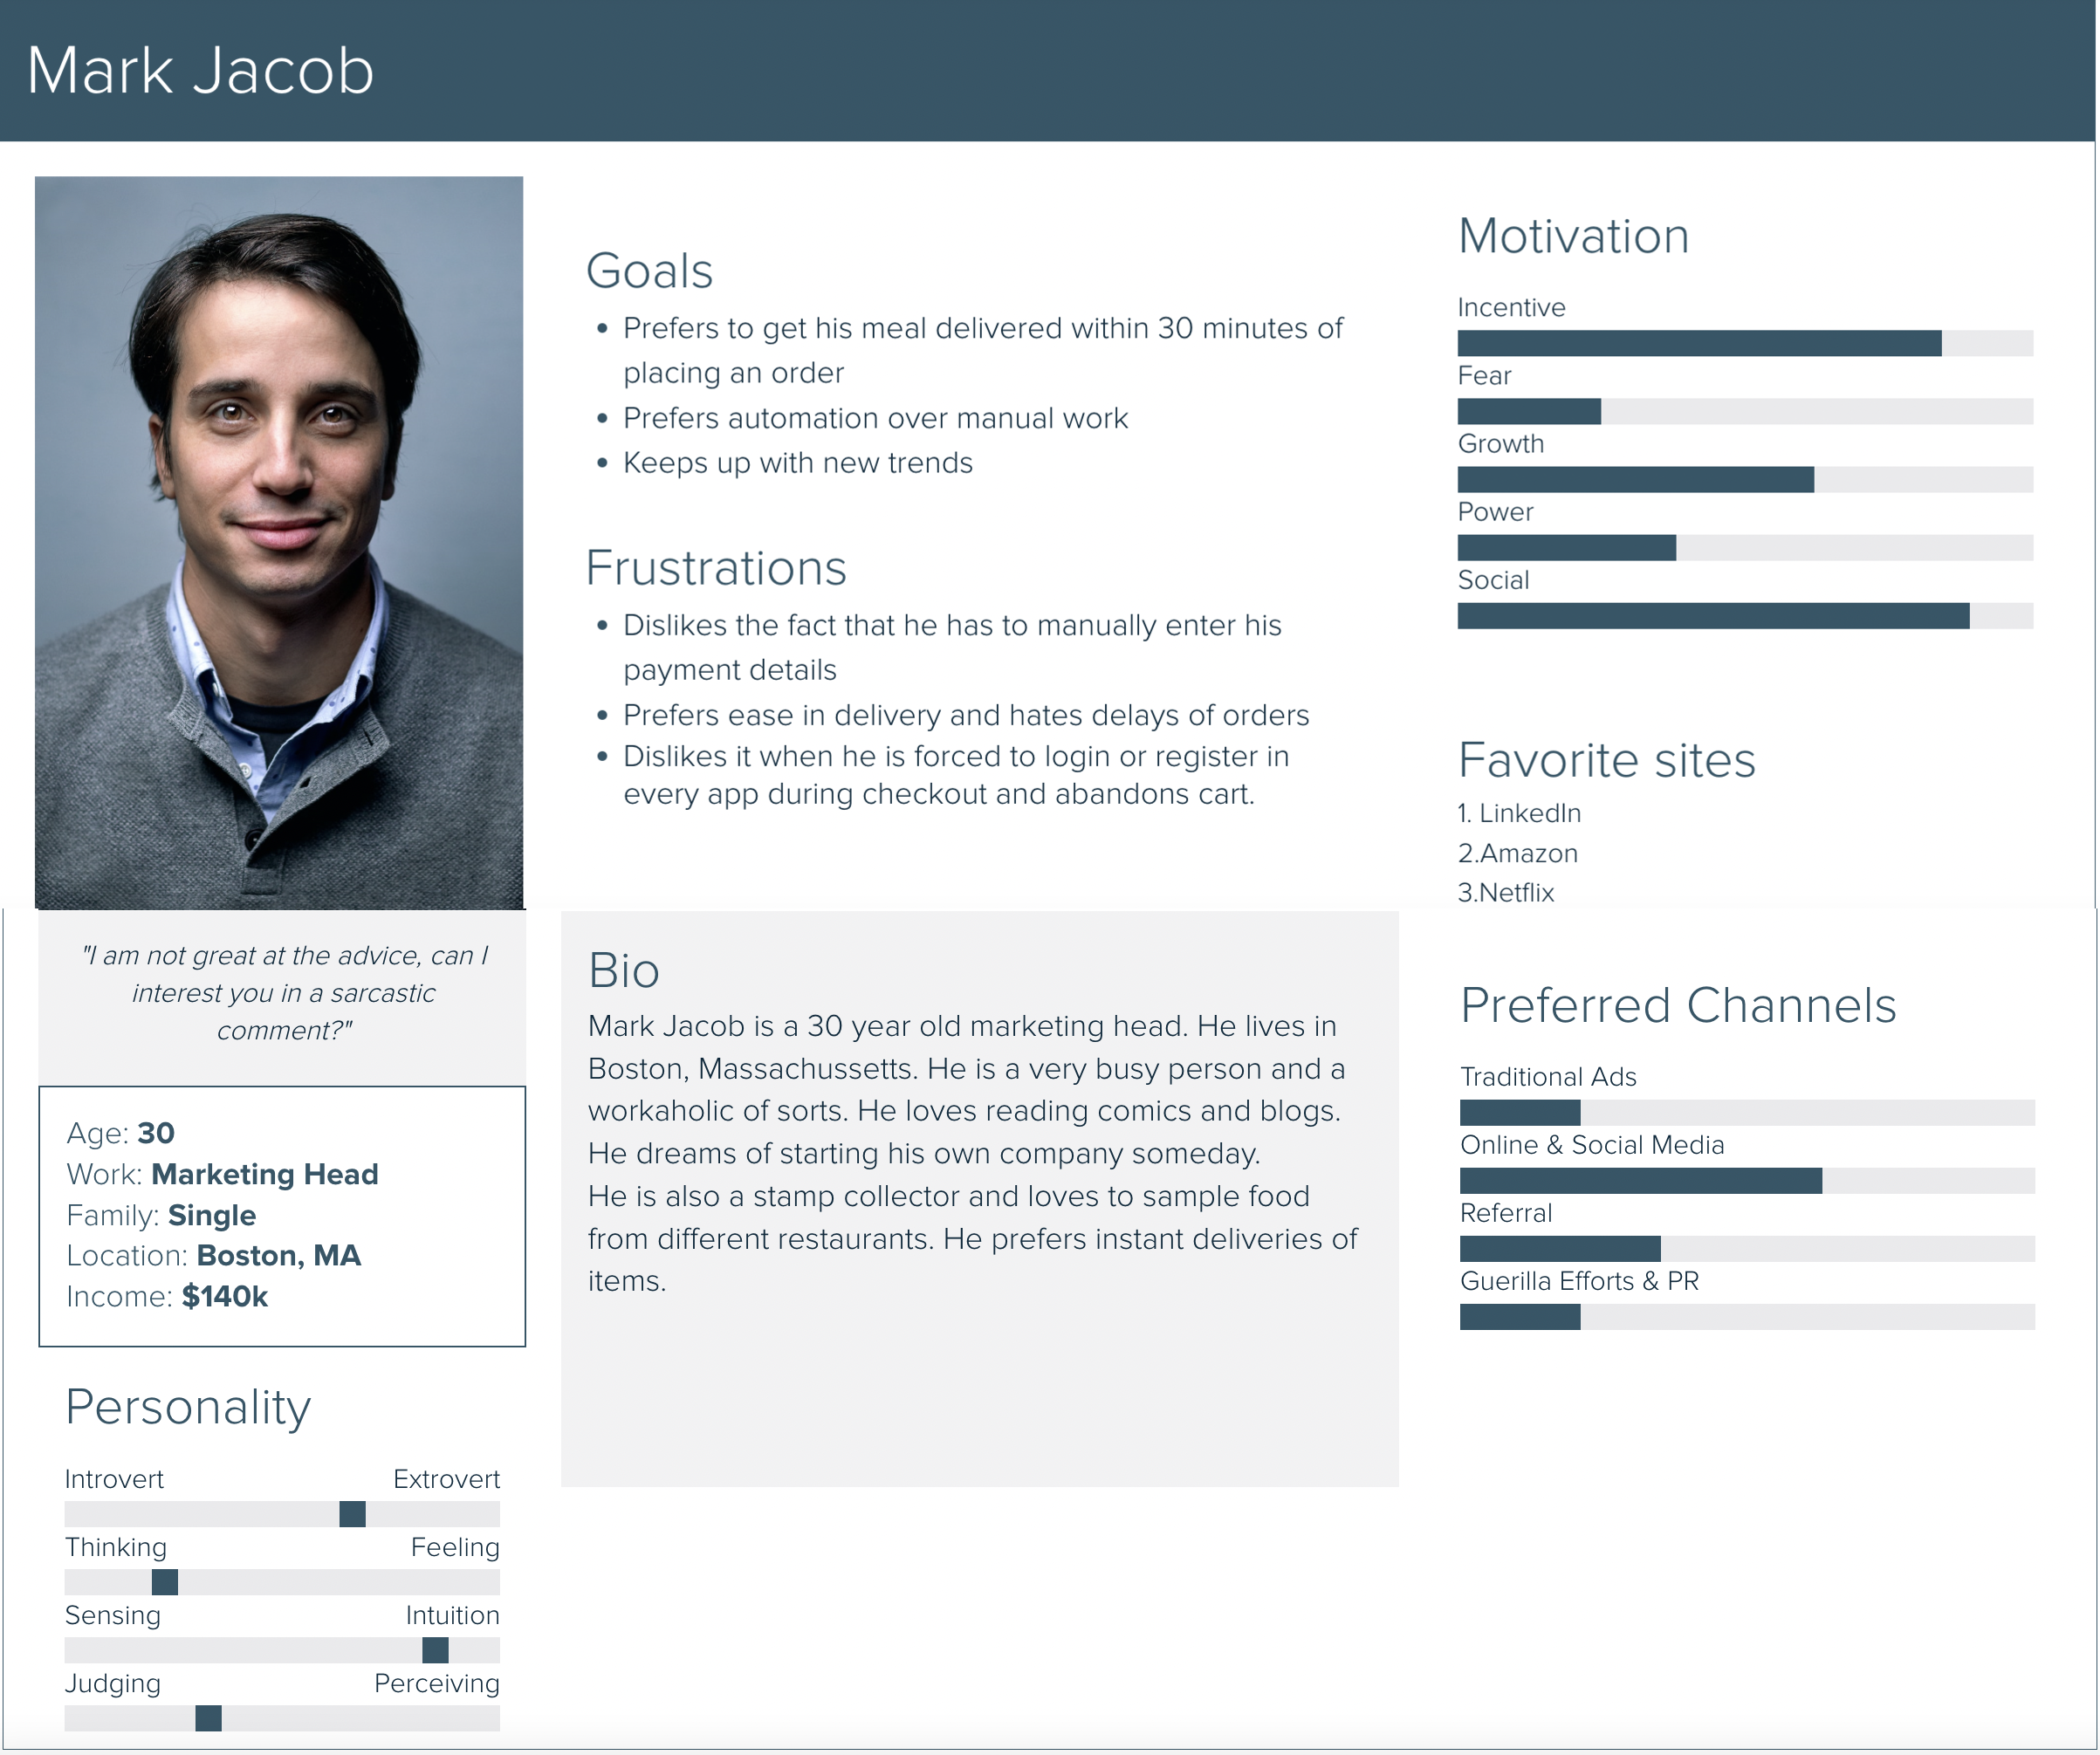

Slide 23
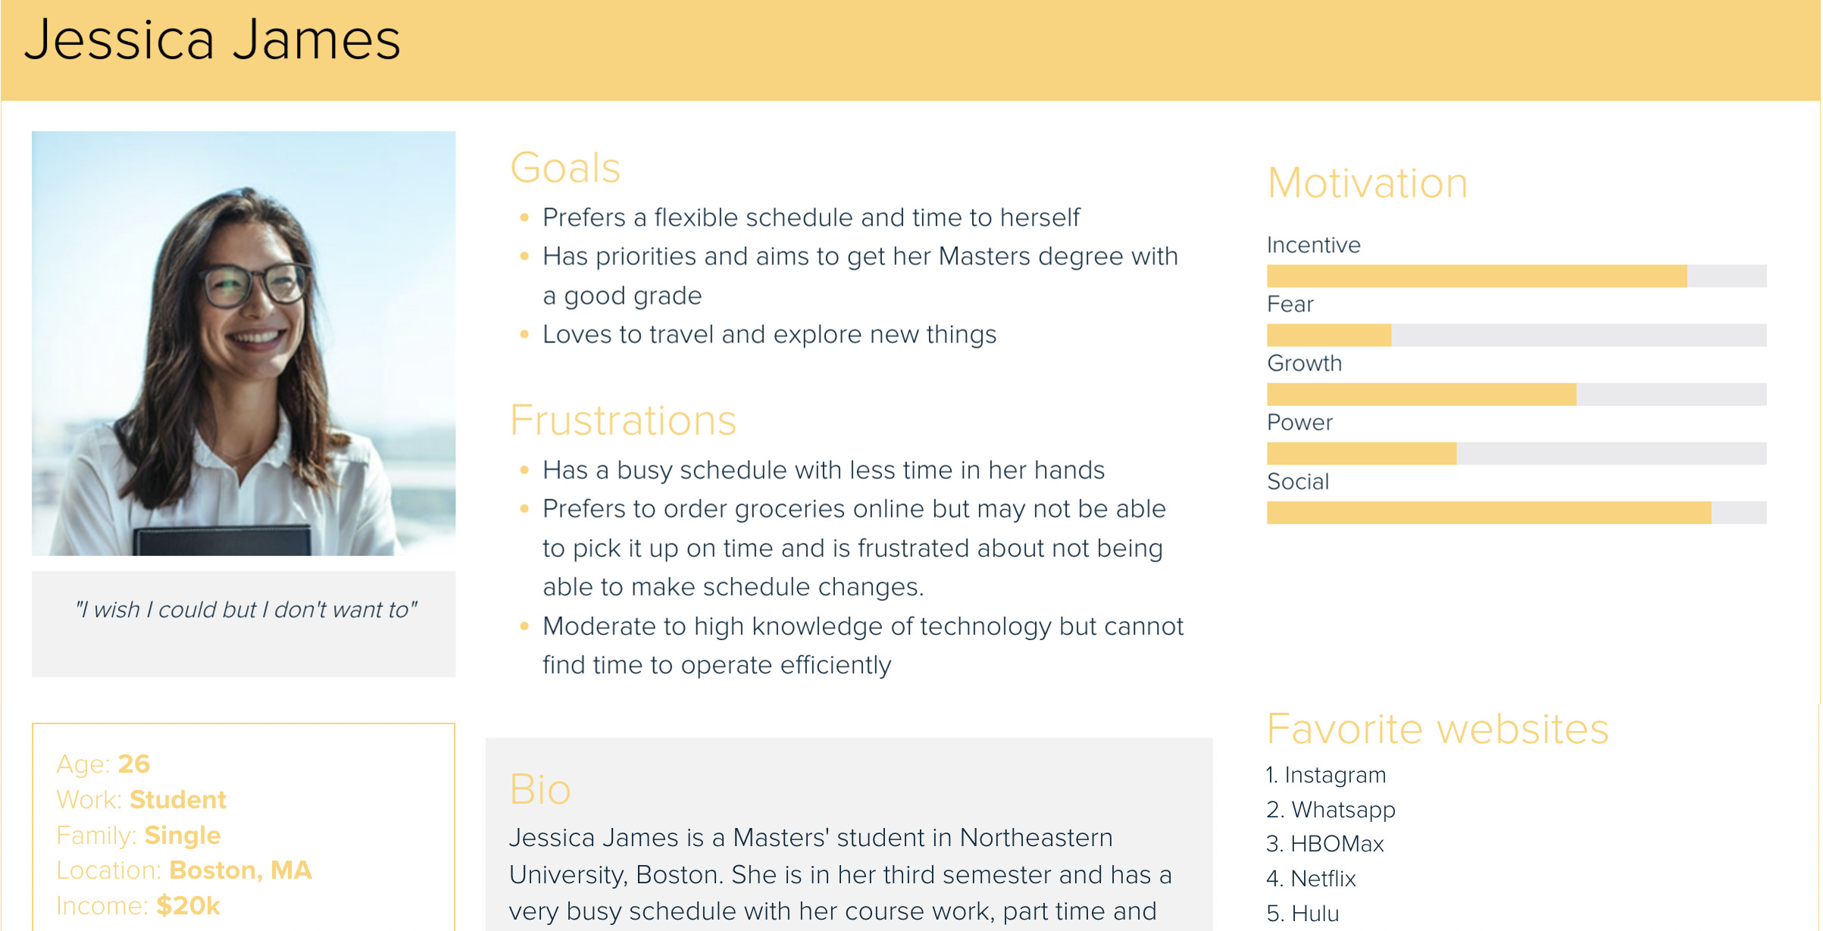

Slide 24
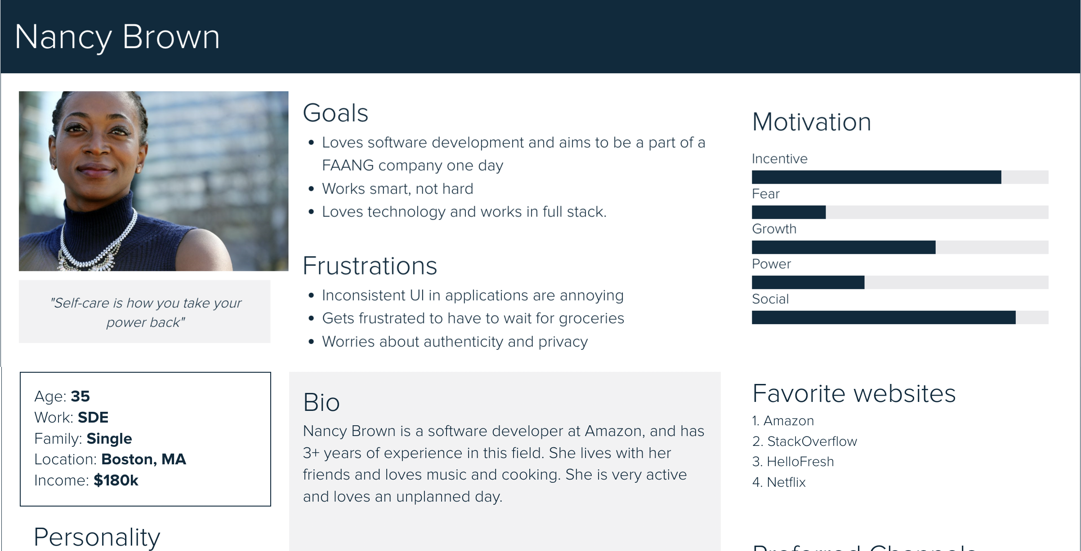

Slide 25

UX Research Methods
Online surveys
Competitive Analysis
Prototype Feedback and Testing

Slide 26
Online Surveys
A set of questions, sent to a targeted group of users, that probes their attitudes and preferences.
Surveys can be a quick, easy, and inexpensive way to obtain data questions you ask.
IT is generally done through filling out a form. Online surveys can vary in length and format.
The data is stored in a database and the survey tool provides some level of analysis of the data; it is also reviewed by an expert.

Slide 27
Questions that can be asked in the survey include:
How did you learn about our website?
Considering your complete experience with our company, how likely would you be to recommend us to a friend or colleague?
How satisfied did you feel based on your overall experience?
Please let us know how we can improve your experience.
Did you get what you were looking for?
Are you going to return later?
Did you like the design?
How easy was it to navigate through the site?
How helpful do you find ratings while making a purchase decision?
Did you find enough product details?
Please rate the below parameters as compared to our competitors – website performance, product info, shipping options, online help, overall

Slide 28
Benefits of online surveys
You learn more about:
Who your users are
What your users want to accomplish
What information your users are looking for
Considerations:
Surveys should be brief
Provide the participant with an estimate of completion time up front, as well as something that indicates their progress
Include a mix of open-ended questions—in which users complete the answer—and closed questions
Ask if a respondent is willing to answer more in-depth questions in a follow-up survey or interview

Slide 29
When to do?
Before a site redesign - learn about current users and what they are trying to accomplish
After launching a new or revised site - learn if your new design meets the needs of users and identify areas for improvement
When you want to have content or features rated or ranked - conduct ongoing surveys to gain ideas for future improvements

Slide 30
Competitive Analysis
Technique use to understand the competition, identify opportunities, and find an edge.
Provides UX design teams with valuable insights to develop a UX strategy that enhances a product’s user experience and business value.
Helps to Develop a UX strategy and prioritize the design process
Discover how competitors solve similar usability issues
Determine competition strengths and weaknesses
Learn about trends and innovation
Building a new Product or Feature
Identify Market Gaps
Support Research

Slide 31
When to do Competitive Analysis?
At the start of a new project during the early stages of the design process.
Types of Competitors
Direct competitors - offer the same goods and services to the same or overlapping target market (Instacart, Getir)
Indirect competitors - operate in the same market space but offer different products – GrubHub, DoorDash, UberEats

Slide 32
Competitive Analysis Research Methods
SWOT Analysis (strengths, weaknesses, opportunities, threats)
Using a Competitor’s Product
Reading Competitors’ Reviews
Comparison Chart
User Journey Comparison
Usability Test on a Competitor’s Prototype

Slide 33
Prototype Feedback and Testing
Creates a design mock-up or a feature prototype
Gathers feedback from your target audience on what to keep and what does not work for them
Identifies potential issues or validate product decisions.
Gathers insights for the current product and learn how it can be modified to best meet the users’ needs, whether that’s a product walkthrough or added in-product widgets

Slide 34
Benefits:
Find issues early on
Discover potential opportunities
How to Test?
Know what you’re testing and why
Define the target audience for your test
Create a prototype
Choose the usability testing technique
Decide which tools you’ll use
Evaluate the test results and implement changes

Slide 35
Tools to create prototypes:
Figma
InVision
Marvel
Moqups
Balsamiq
Tools to test prototypes:
Maze
Lookback
UXtweak

Slide 36

Thank you!

